Slide 1

PREDICTING AUTISM DISORDER
TEAM
SANDHYARANI CHEELAMANTHULA
VENKAT BINDU
RAGHUPRIYA NEKKALAPU

Slide 2
TOPICS COVERED :
PROBLEM SUMMARY
PROGRESS SUMMARY
WORK SUMMARY
RESULTS
CONCLUSION AND FUTURE WORK

Slide 3
PROBLEM STATEMENT
Problem: Classification method to classify ASD diagnosis using ASD screening dataset is the Deep Neural Network (DNN).
Motivation: We see deep neural network as a tool that can augment human capabilities, translating theory into practice to solve real problems with human-centred values.
Significance: Applying Deep neural network , which has been a popular method in recent years and proved to improve classification accuracy. This project aims to analyze the performance of DNN model in the diagnosis of ASD in terms of classification accuracy

Slide 4
DATASET PREPARATION
Before the model is developed, the datasets underwent a few pre-processing steps. One of them is eliminating missing values.
The dataset contained a of missing values in two variable is which are dropped so that the data can be well-utilized.
Data pre-processing was challenging since datasets mostly consist of categorical variables and only two numerical variables. However, by using tools such as the scikit-learn, data pre-processing is done smoothly

Slide 5
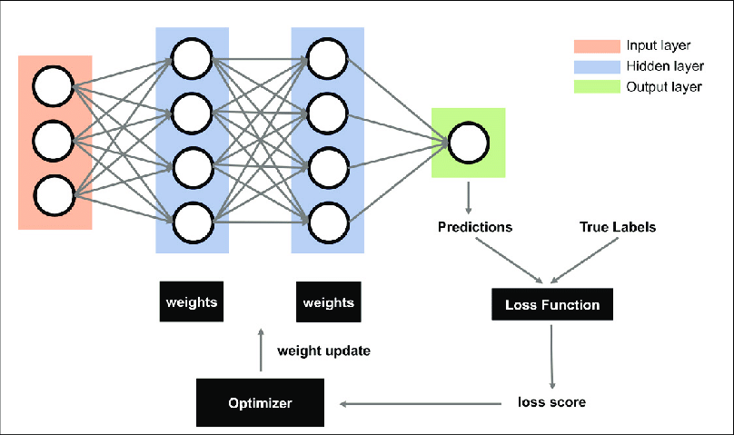
WORK SUMMARY:

Slide 6
Deep Neural Network Model
We developed a DNN model using Keras Sequential API.
Keras is high level neural network API which is written in python programming.
DNN is designed based on the neurons in the human brain. With deeper layers a model is developed.
Firstly we need to propose a DNN model, it is important to determine the architecture of the model and determine the activation function that will be used in the development of the model DNN.

Slide 7
There are two main hyperparameters in a neural network, which is the number of layers and the number of nodes.
Both hyperparameters need to be tuned to find the model with the best accuracy.
Therefore, the number of nodes and the number of hidden layers were set by using an experimental method, where the number of nodes and layers were changed in each experiment in the datasets, and the best result from the experiments will decide the number of layers as well as the number of nodes in each layer.

Slide 8
Other than the number of nodes and layers, there are also a few other hyperparameters applied in the model such as the activation function, drop-out rate, optimizer and batch size.
These hyperparameters are set for datasets.
These hyperparameters are set based on the best results obtained after each experiment..

Slide 9
HYPERPARAMETERS
Activation function (hidden layers): ReLU
• Dropout: 0.3 / 0.4
• Activation function (output layer): Sigmoid
• Batch size: 10
• Optimiser: Adam
• Loss: binary crossentropy

Slide 10
For the activation function, ReLU is used because it has been the standard activation function for deep learning models.
In this study as well, ReLU seemed to provide a good result for the model. Sigmoid, on the other hand, is a very suitable function for output layers because it exists between (0 to 1) and is suitable for binary classification.

Slide 11
Define Model
We create a sequential model and add layers one at a time until we are happy with our network architecture.
The first thing to get right is to ensure the input layer has the right number of input features. This can be specified when creating the first layer with the input_dim argument and setting it
How do we know the number of layers and their types?
process of trial and error experimentation
we used a fully-connected network structure with layers.
Fully connected layers are defined using the Dense class(all the neurons in a layer are connected to those in the next layer).

Slide 12
We can specify the number of neurons or nodes in the layer as the first argument, and specify the activation function using the activation argument.
We will use the rectified linear unit activation function referred to as ReLU on the hidden layers and the Sigmoid function in the output layer.
These days, better performance is achieved using the ReLU activation function. We use a sigmoid on the output layer to ensure our network output is between 0 and 1
The first hidden layer has 94 nodes and uses the relu activation function. Hideen layers with the relu activation function.The output layer has one node and uses the sigmoid activation function.

Slide 13
Compile the model
We must specify the loss function to use to evaluate a set of weights, the optimizer is used to search through different weights for the network and any optional metrics we would like to collect and report during training.
In this case, we will use cross entropy as the loss argument. This loss is for a binary classification problems and is defined in Keras as “binary_crossentropy“.
We will define the optimizer as the efficient stochastic gradient descent algorithm “adam“. This is a popular version of gradient descent because it automatically tunes itself and gives good results in a wide range of problems.

Slide 14
Fit the model
We can train or fit our model on our loaded data by calling the fit() function on the model.
Training occurs over epochs and each epoch is split into batches.
Epoch: One pass through all of the rows in the training dataset. It is the number of complete passes through the training dataset.
Batch: One or more samples considered by the model within an epoch before weights are updated.
One epoch is comprised of one or more batches, based on the chosen batch size and the model is fit for many epochs.
For this problem, we will run for a small number of epochs (350) and use a relatively small batch size of 10.

Slide 15
RESULTS SUMMARY:
The DNN model is built to classify ASD diagnosis.
Data is provided and fitted into the model and the performance of the model is analyzed and evaluated using the performance calculations The performance of the model will be explained based on dataset.
DNN model for the dataset was run on 350 epochs.
The accuracy of the classification model consistently increases.
After the results of epochs are obtained, the model assessment is also computed using the confusion matrix to further evaluate the classifier. The evaluation metrics carried out for the evaluation includes the accuracy, precision, recall, f1-score, support.

Slide 16
Based on the results obtained through the confusion matrix, the performance calculation is computed. According to the result computed, it is shown that the result of DNN classifier performance using the dataset is quite good.

Slide 17
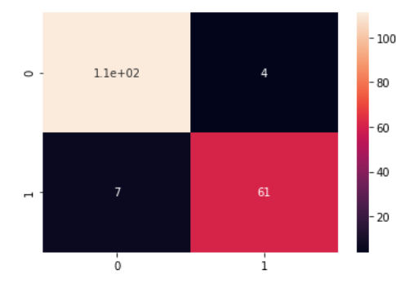
CONFUSION MATRIX OF DATASET True condition predicted Condition
 | Actual NON ASD | Actual ASD
Predicted: Non ASD | TN=111 | FP=4
Predicted: ASD | FN=7 | TP=61

Slide 18
Sensitivity = (TP / (TP + FN)) * 100 =89
Specificity = (TN / (TN + FP)) * 100 =96
To estimate the sensitivity of a test is its ability to determine the patient cases correctly.
To estimate it, we calculate the proportion of true positive in patient cases.
The specificity of a test is its ability to determine the healthy cases correctly. To estimate it, we calculate the proportion of true negative in healthy cases.

Slide 19
RESULTS OF DNN CLASSIFIER
 | ACCURACY
RESULT | 97.81

Slide 20
Conclusion and Future work
The main goal of this study is to implement a supervised deep-learning algorithm using DNN with ASD screening dataset, with the hope to produce a model that can accurately classify ASD cases and non-ASD cases.
The datasets used in this study was published in December 2017. Therefore, there are only a small number of work that has been done using these dataset.
With that, this proposed model is hoped to be able to become a benchmark for the future work related to these datasets.

Slide 21
Overall, the proposed DNN model is well-developed and has produced a good classification result in classifying ASD with the given attributes of the patients’ behavior.
However, it is very advisable to use a larger dataset in order to obtain a better performance of DNN model in order to claim that the model is accurate and robust enough to classify the data without the risk of overfitting.
In this study, however, the results of the proposed model are good enough in classifying adults with ASD and have proven to be significant model in order to claim that the model is accurate and robust enough to classify the data without the risk of overfitting.

Slide 22


